Slide 1
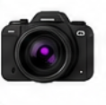

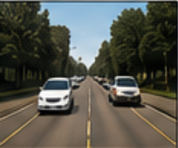
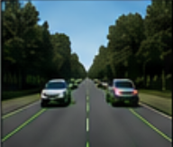
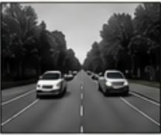
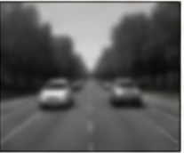
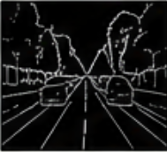
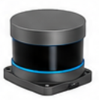


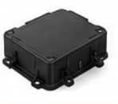






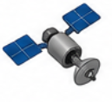



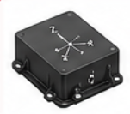
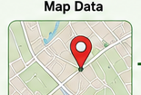
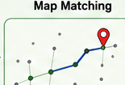
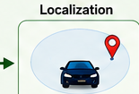






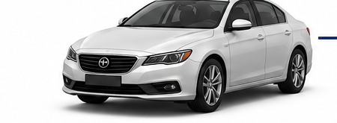
AUTONOMOUS VEHICLE PERCEPTION SYSTEM
INPUT SENSORS
PERCEPTION
PLANNING
Camera
1. IMAGE ACQUISITION & PREPROCESSING
Route Planning
(Images)
Input Image
Resize
Grayscale
Gaussian Blur
Edge Detection
Path Planning
LiDAR
(Point Cloud)
Obstacle Avoidance
2. PERCEPTION TASKS
Lane
Detection
Vehicle
Detection
Pedestrian
Detection
Traffic Sign
Detection
Traffic Light
Detection
Speed Planning
Radar
(Objects &
Velocity)
CONTROL
GPS
Steering
Controller
Speed
Controller
Brake
Controller
(Position)
LOCALIZATION
Map Data
Map Matching
Vehicle
Localization
IMU
Actuation Commands
(Steer, Accelerate, Brake)
Motion & Orientation
LEGEND
VEHICLE OUTPUT
Perception
Localization
Planning
Control
Lane
Keeping
Obstacle
Avoidance
Speed
Control
Traffic Sign &
Light Recognition
Safe
Navigation
Sensor Data Flow

